Slide 1

Customer Shopping Behavior Analysis
Uncovering insights from 3,900 purchases across product categories to guide strategic business decisions.

Slide 2
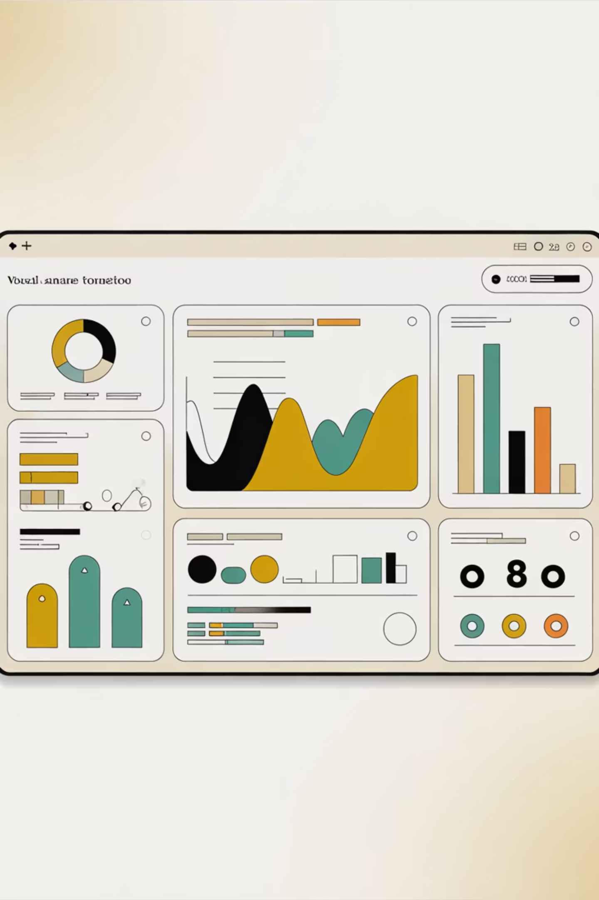
Dataset Overview
3,900 Purchases
Transactions analyzed across multiple categories
18 Features
Demographics, purchase details, and behavior data
50 Locations
Geographic distribution of customer base
37 Missing Values
Review ratings imputed by category median

Slide 3
Data Preparation & Cleaning
01
02
03
Data Loading
Initial Exploration
Missing Data
Imported dataset using pandas
Checked structure and summary statistics
Imputed review ratings by category
04
05
Feature Engineering
Database Integration
Created age groups and purchase frequency columns
Loaded cleaned data into PostgreSQL

Slide 4
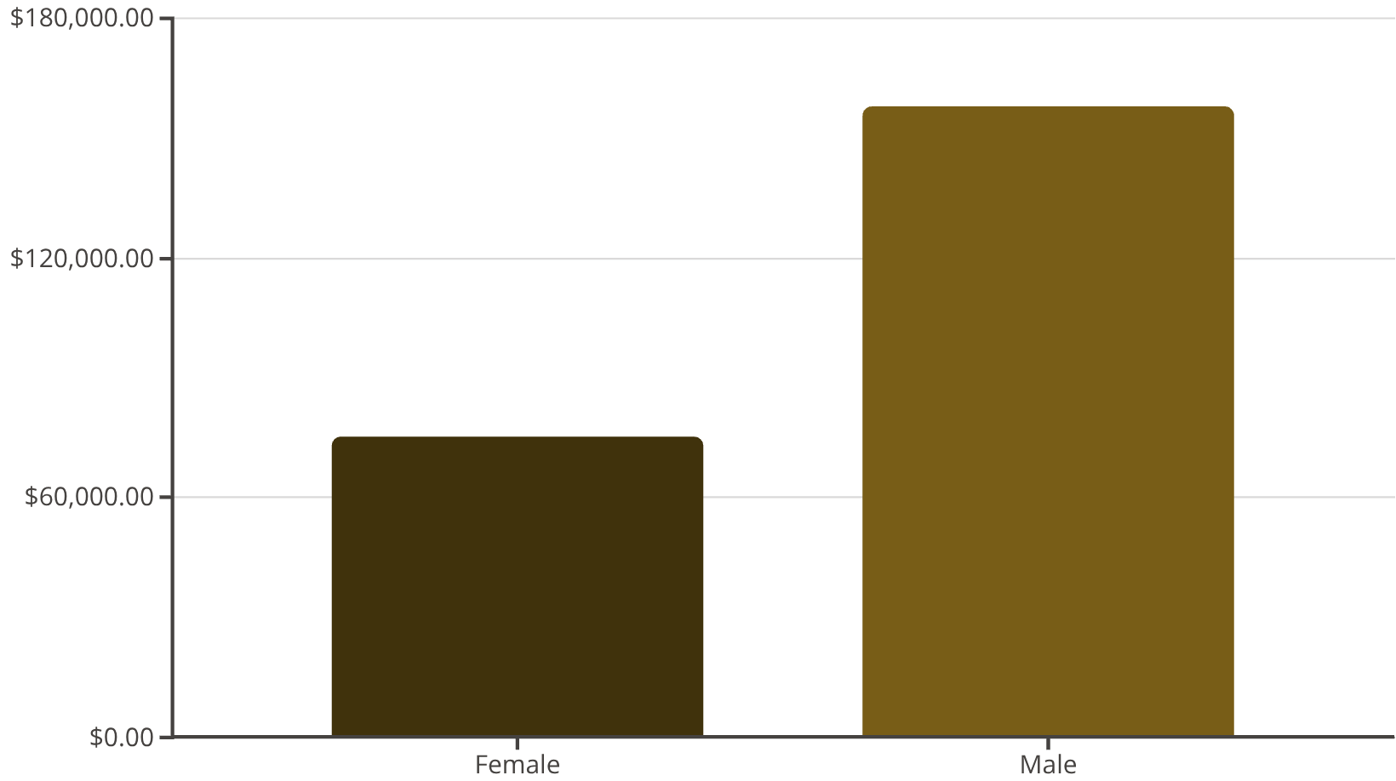
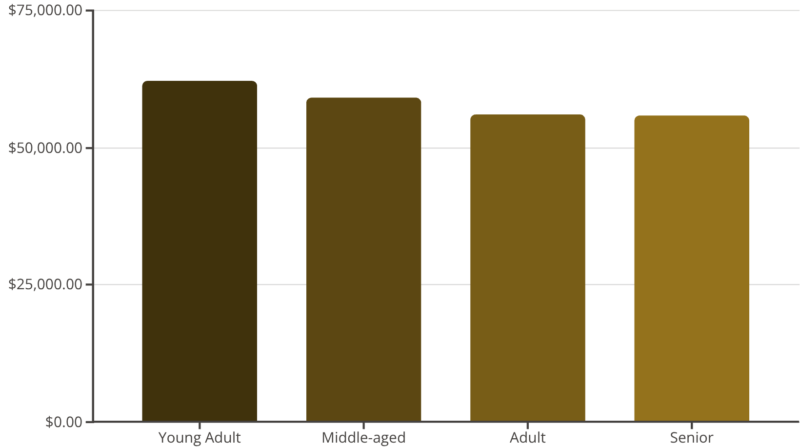
Revenue Insights
Revenue by Gender
Revenue by Age Group

Slide 5




Customer Segmentation
Returning
701 customers
Loyal
Potential for increased engagement
3,116 customers
Repeat purchasers driving core revenue
New
83 customers
Opportunity for conversion and retention

Slide 6
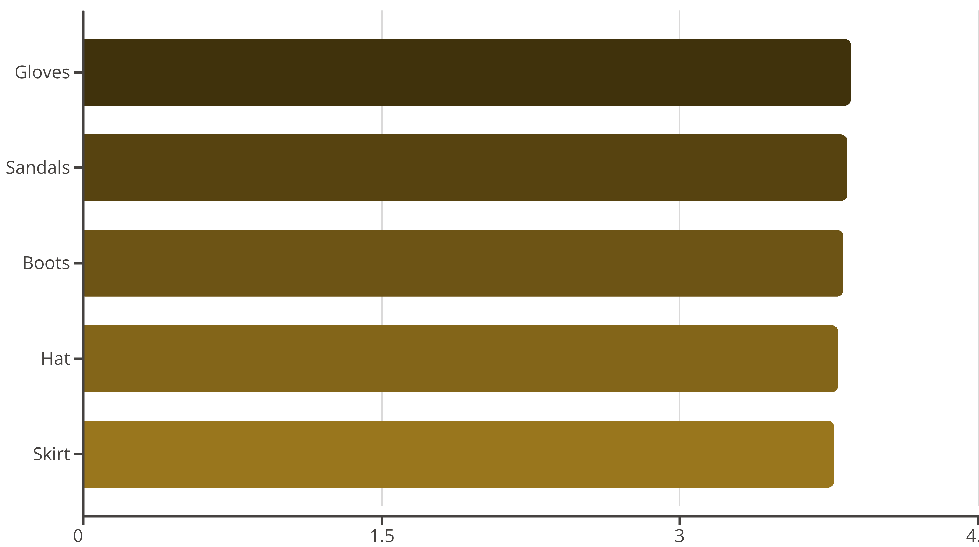
Product Performance
Top 5 Products by Rating

Slide 7
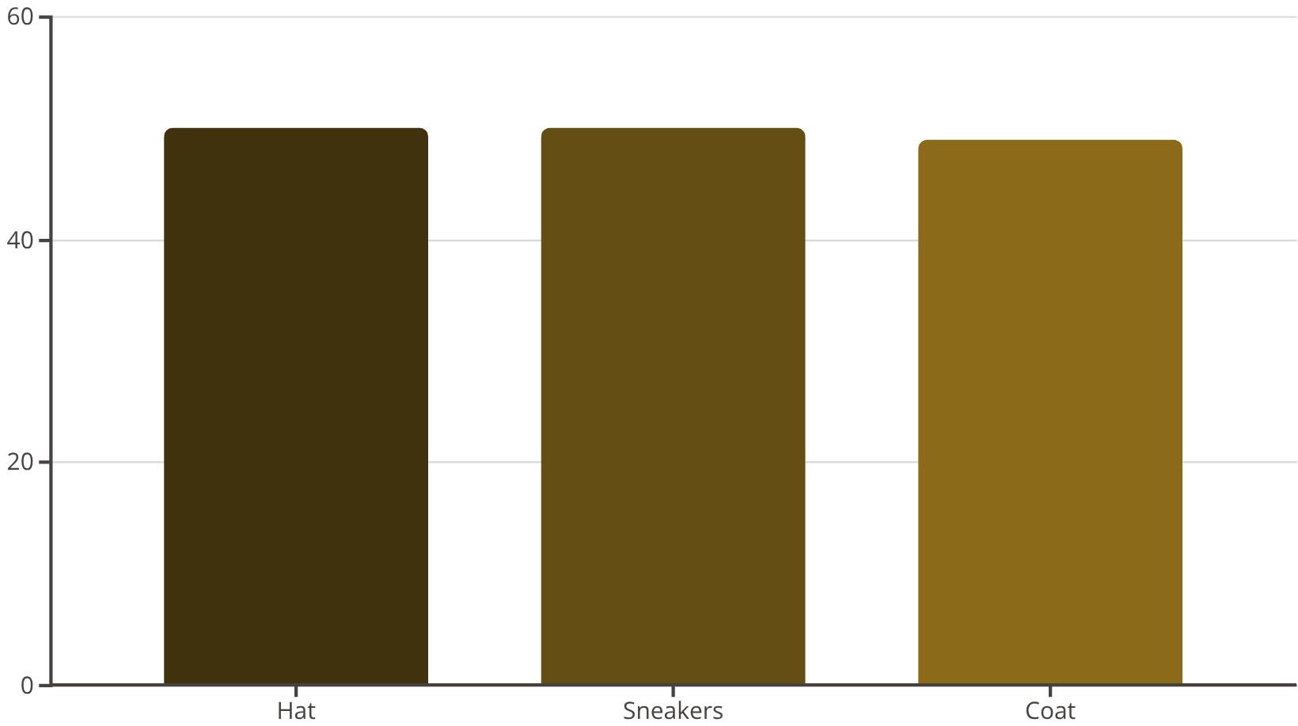
Discount & Subscription Patterns
Discount-Dependent Products
Subscribers vs. Non-Subscribers
Status
Customers
Avg Spend
Subscribers
1,053
$59.49
Non-Subscribers
2,847
$59.87

Slide 8

Shipping & Purchase Behavior
Standard Shipping
Express Shipping
Average purchase: $58.46
Average purchase: $60.48
Most common choice among customers
Higher-value transactions
Free Shipping
Most popular option (675 orders)
Key driver of purchase decisions

Slide 9
Strategic Recommendations
1
Boost Subscriptions
Promote exclusive benefits to increase subscriber base
2
Loyalty Programs
Reward repeat buyers to move customers into Loyal segment
3
Review Discount Policy
Balance sales boosts with margin control on high-discount items
4
Product Positioning
Highlight top-rated and best-selling products in campaigns
5
Targeted Marketing
Focus on high-revenue age groups and express-shipping users

Slide 10
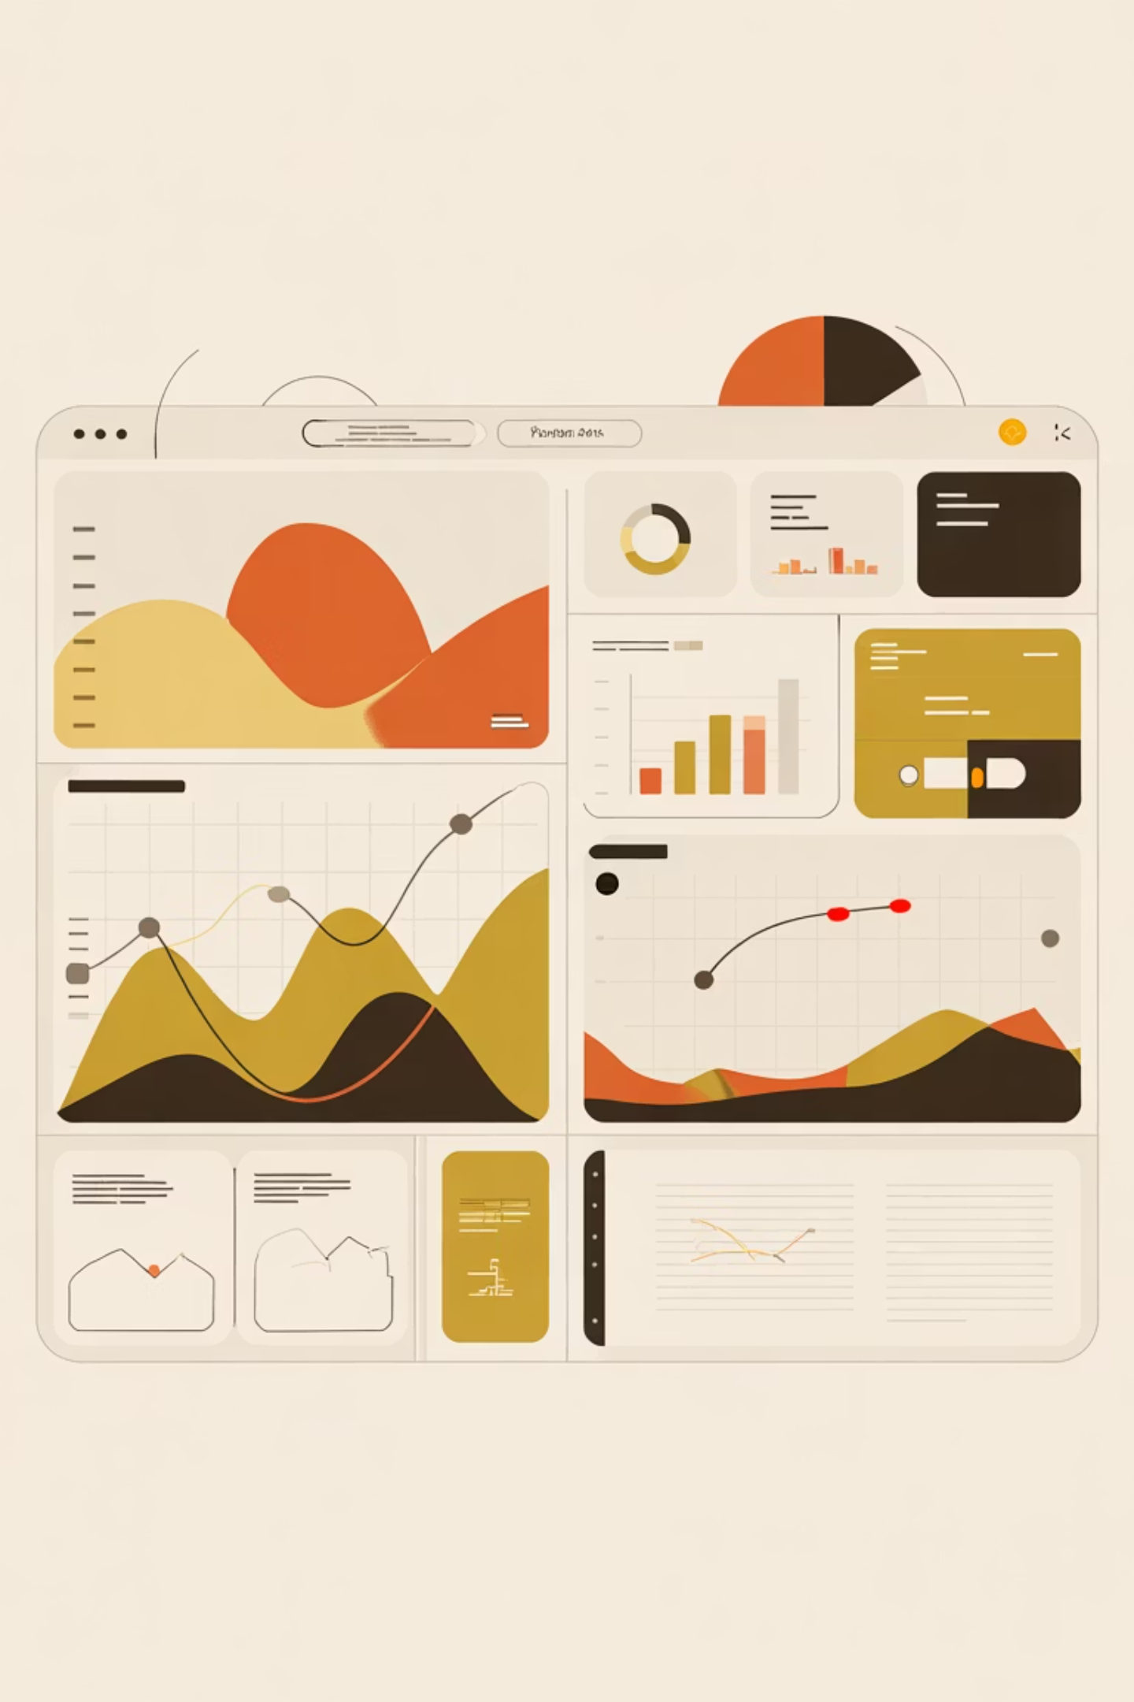

Dashboard & Next Steps
Interactive Power BI dashboard created for real-time insights and performance tracking.
Key Takeaway: Leverage customer segmentation and product performance data to drive targeted marketing, optimize discount strategies, and increase subscription adoption for sustainable revenue growth.

